Slide 1
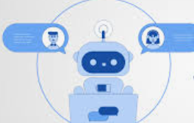
Chat assistant
MINI PROJECT

Slide 2
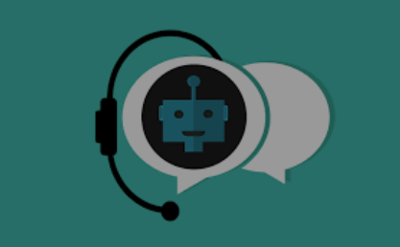
ABSTRACT
Chatbot is a computer program which stimulates a conversation between a user and a computer.
In this project we are using tkinter module for GUI. We are using random module to generate random responses . We are using regular expressions module to match the messages.
Chatbots work by analyzing the user’s request and delivers the appropriate response.
Main importance of chatbot is it is integrated with various websites so that if customers have any queries they can first chat with chatbot like they are talking to a real person.

Slide 3
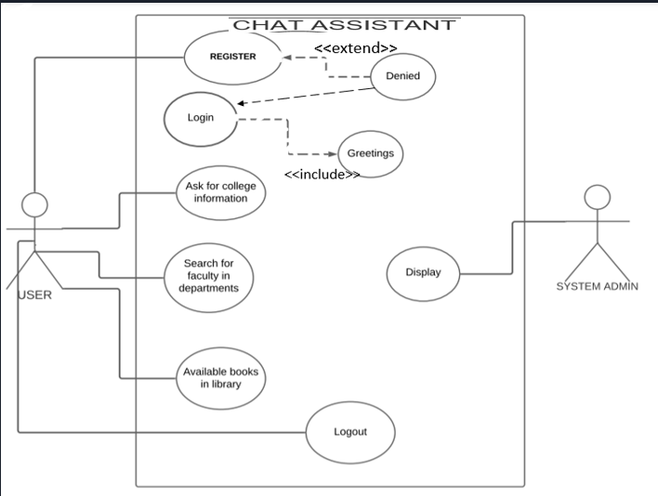
USE CASE DIAGRAM

Slide 4
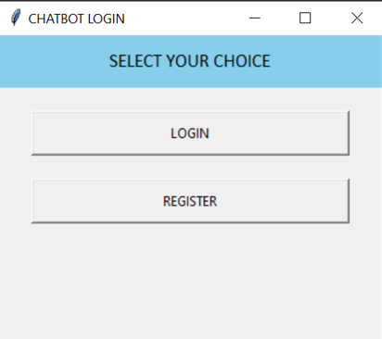
TO LOGIN OR REGISTER

Slide 5
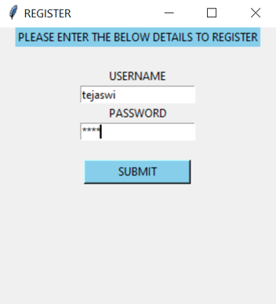
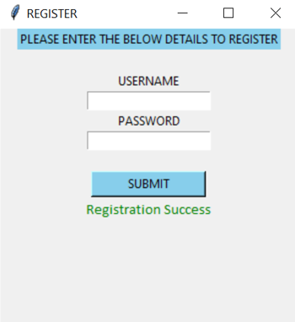
REGISTER

Slide 6
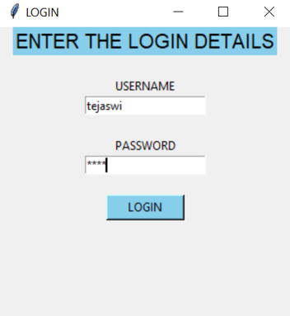
LOGIN

Slide 7
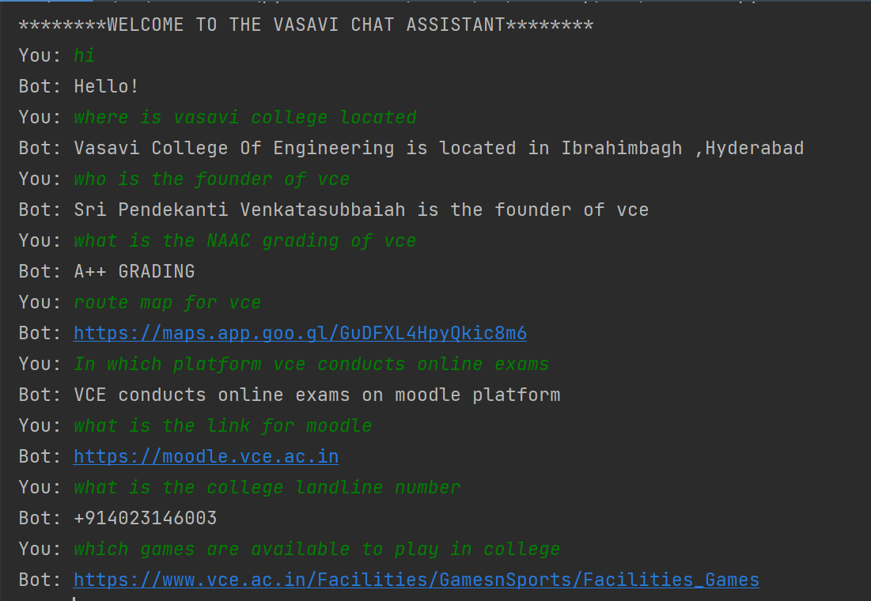
INFORMATION ABOUT COLLEGE

Slide 8
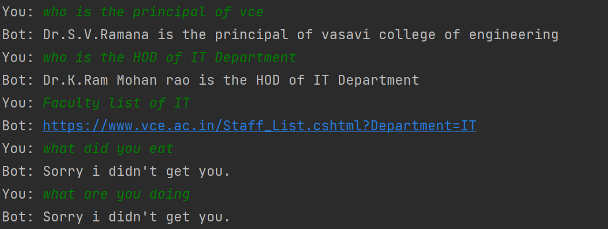
INFORMATION ABOUT FACULTY

Slide 9
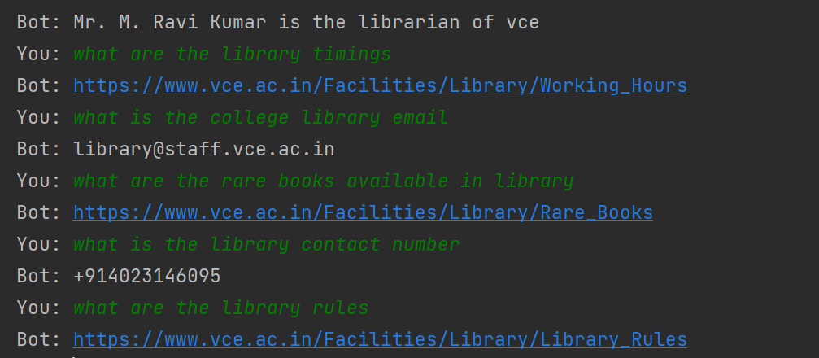
INFORMATION ABOUT LIBRARY

Slide 10
CONCLUSION AND FUTURE SCOPE:
Chatbots are becoming more conversational to communicate effectively.
The future scope of chatbots could include many benefits for enterprises.
Chatbots are fully functioning, semi-autonomous systems that can assist customer service experiences and response time.
The future of chatbots is that businesses will automate simple payments and allow users to pay directly over live chat or facebook messenger apps.

Slide 11


